Slide 1
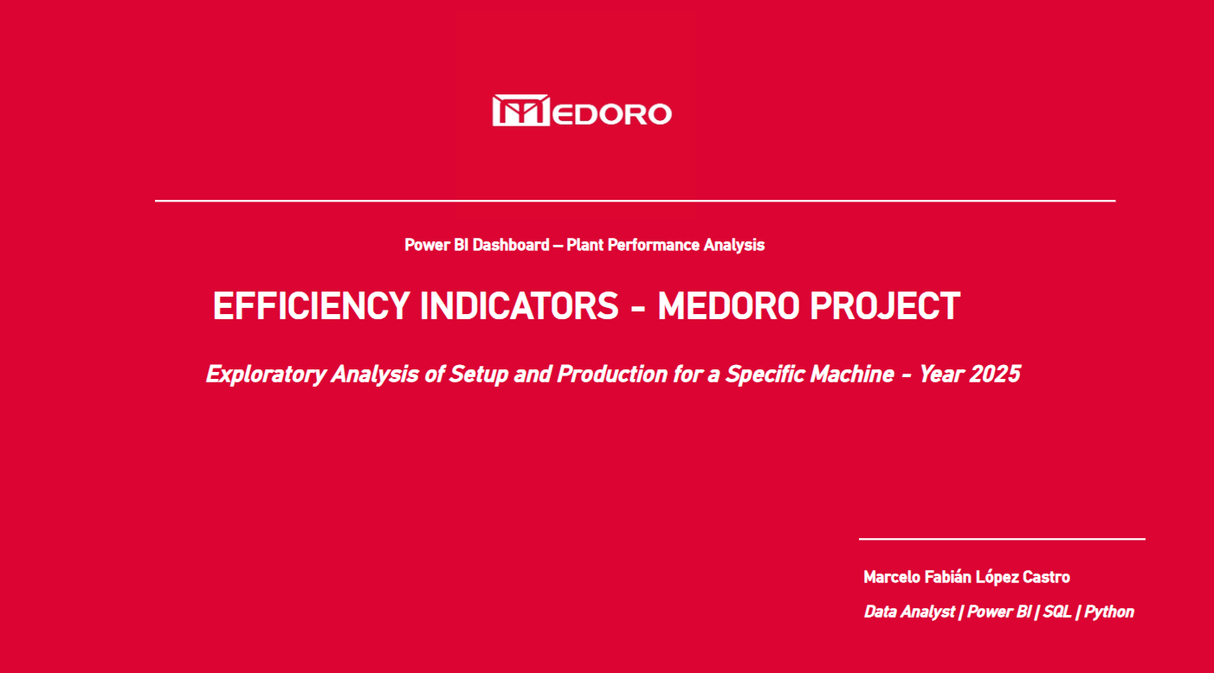

Slide 2
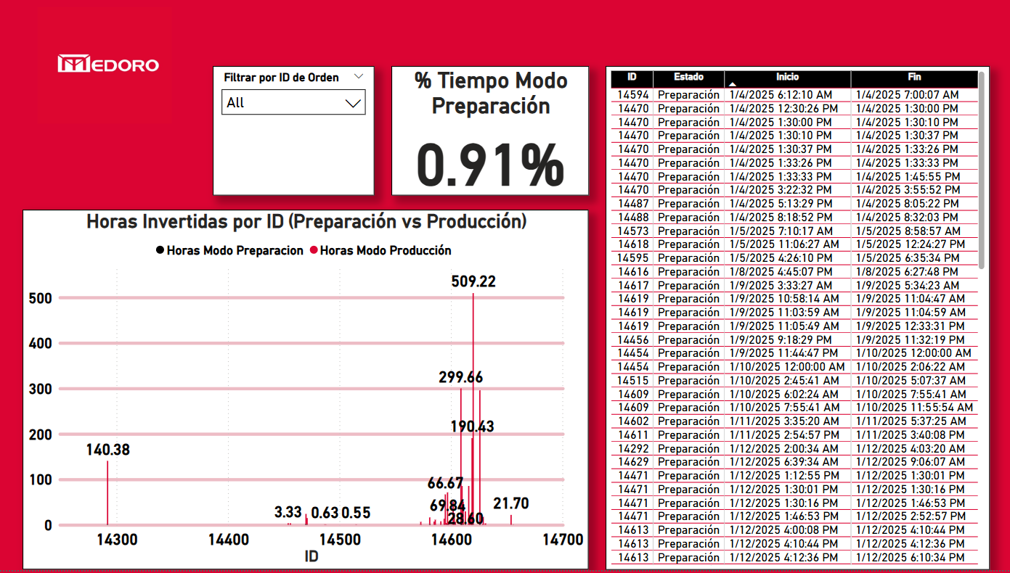
Notes:
This slide displays the overall percentage of time spent in Setup Mode across all work orders processed by a specific machine in 2025.
The bar chart compares the hours invested in setup and production per order ID, helping identify discrepancies and potential inefficiencies in preparation time distribution.

Slide 3
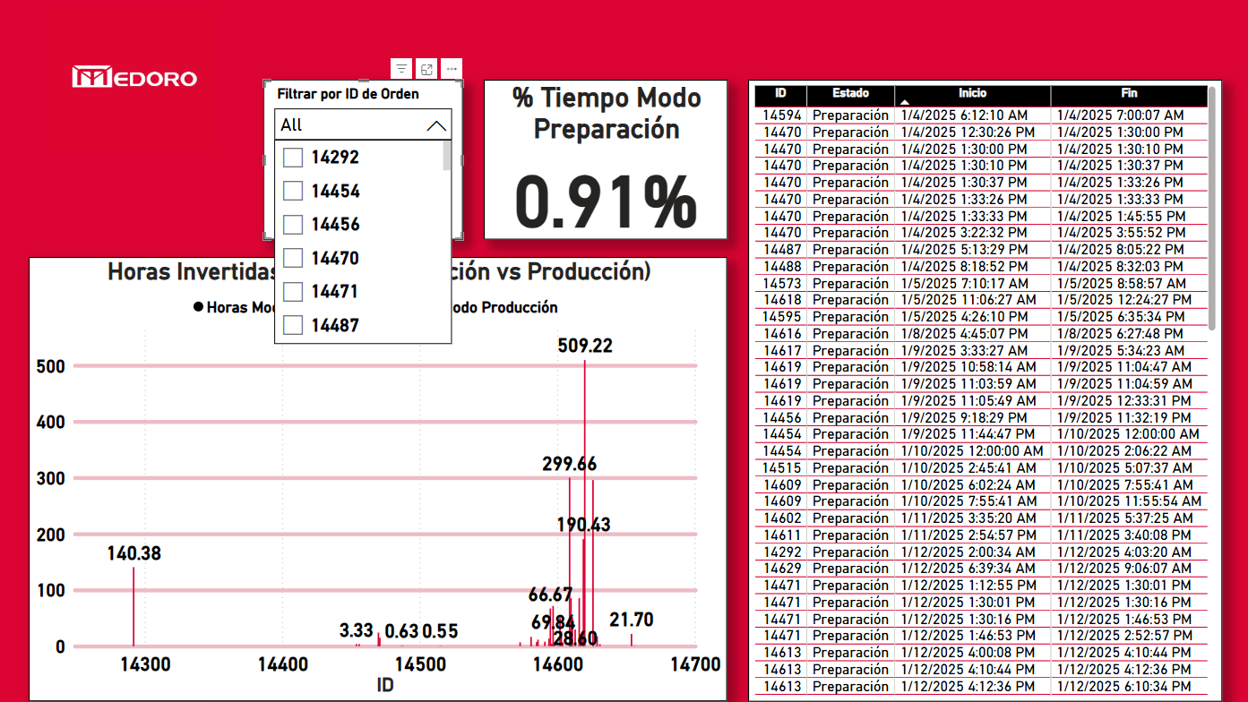
Notes:
This slide illustrates the dynamic filtering capabilities of the dashboard.
By selecting a specific work order ID, users can drill down into its detailed setup and production times. This helps isolate anomalies and better understand individual performance metrics.

Slide 4
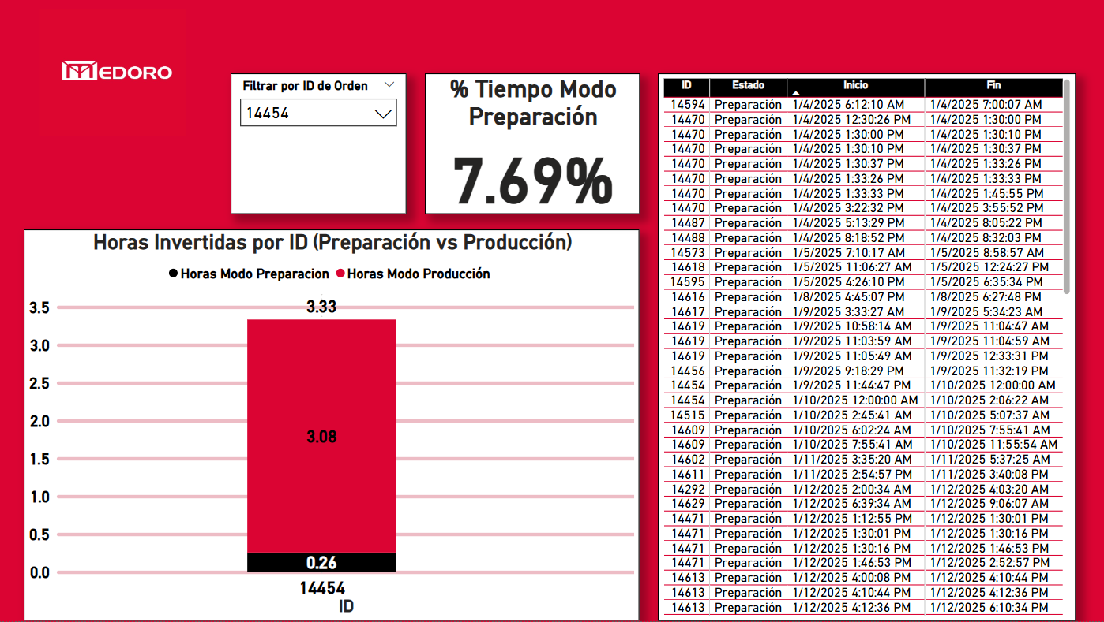
Notes:
Example: Work Order 14454
This work order shows a setup time of 0.26 hours and a production time of 3.08 hours, resulting in a setup time percentage of 7.69%.
Visualizing these individual cases allows us to identify where preparation time might be disproportionately high, helping detect inefficiencies or operational issues.

Slide 5

Notes:
Example: Work Order 14581
In this case, the setup time reaches 1.46 hours versus 14.62 hours of production, resulting in a setup time percentage of 9.09%.
By comparing multiple orders individually, it's possible to assess variability in efficiency across operations, even for the same machine.

Slide 6
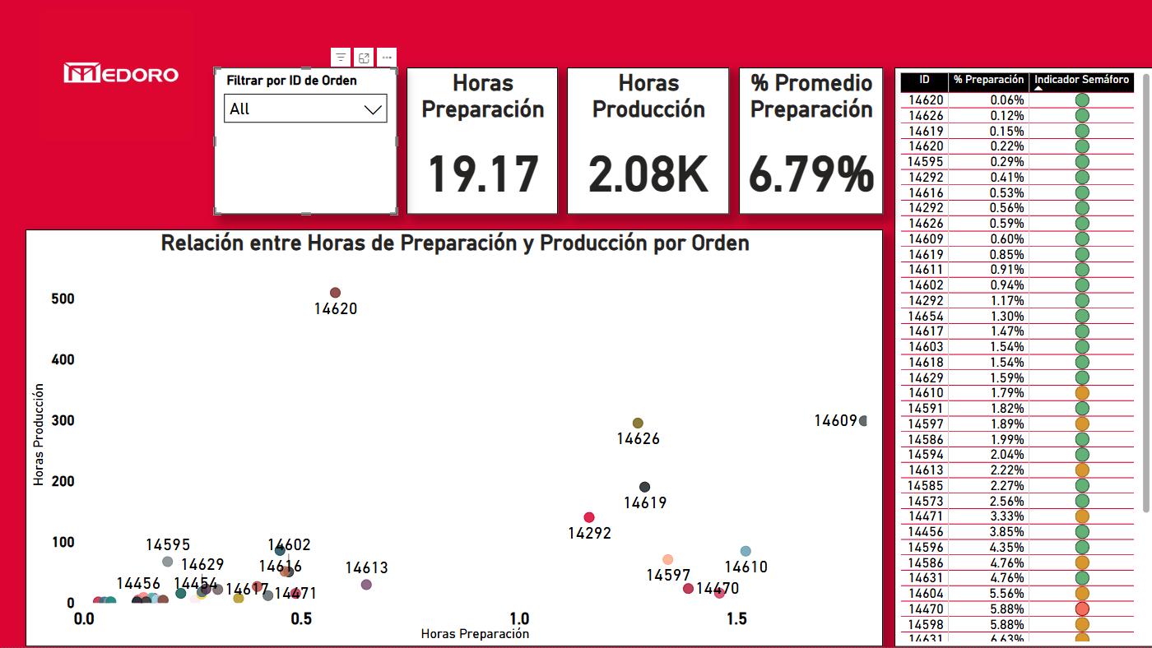
Notes:
Global Comparison – Setup vs. Production Time
This scatter plot compares setup hours (X-axis) and production hours (Y-axis) for each work order. It helps detect outliers and patterns across operations. For example, some orders show high setup time relative to production, potentially indicating inefficiencies.
On the right, a traffic light indicator offers a quick visual cue for each case.

Slide 7
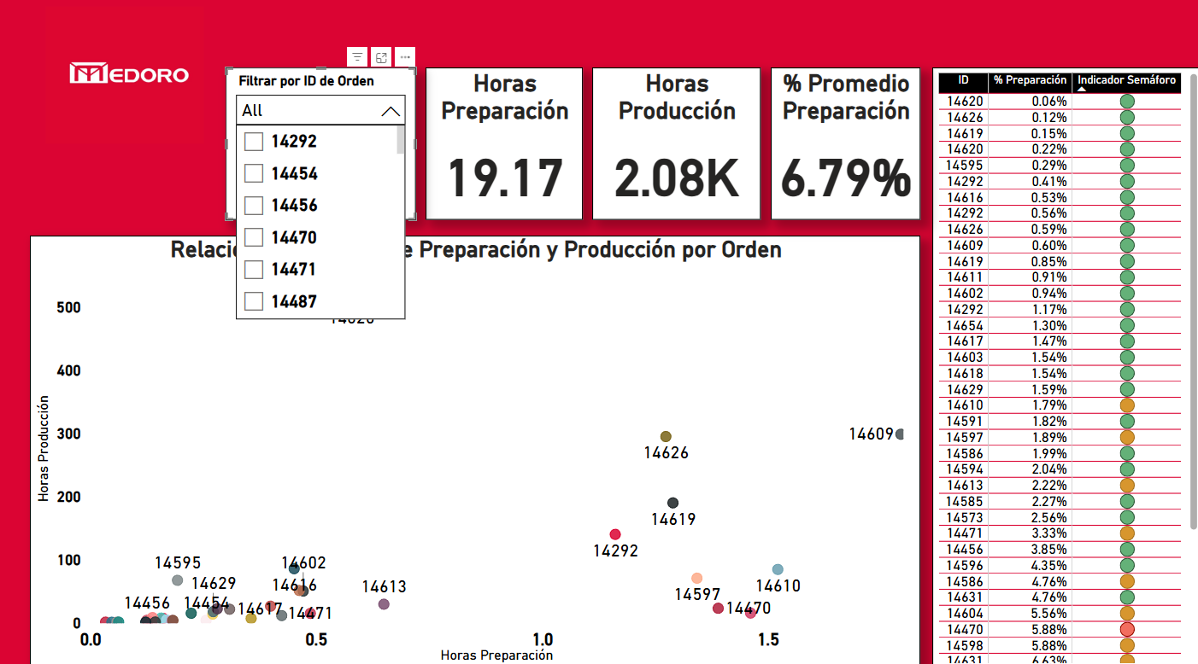
Notes:
Custom Filtering for Deeper Insight
The user can filter the entire dashboard by selecting a specific Work Order ID. This feature enables focused analysis, helping identify why certain orders show higher or lower setup time proportions than average.
It's an essential tool for investigating potential inefficiencies.

Slide 8
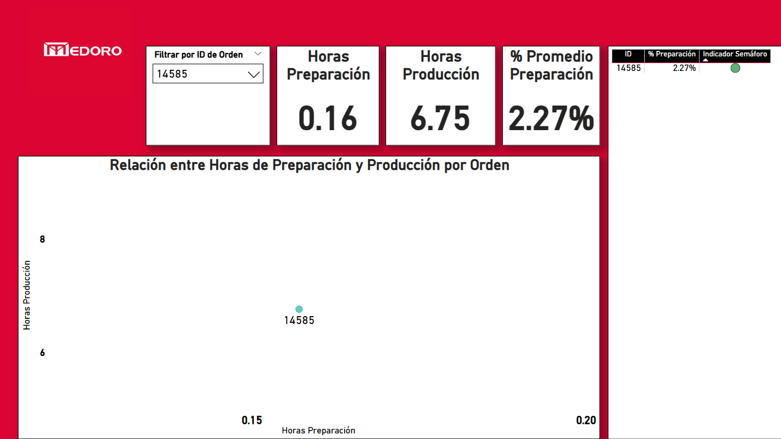
Notes:
Case Example: Efficient Setup Time
Order ID 14585 shows an excellent balance, with only 2.27% of the total time spent in setup mode. This insight helps validate process efficiency and supports benchmarking for future improvements.

